Slide 1

ABRISK and Feature Matching
Derek Slater & Shakeel Khan

Slide 2
Accomplishments/ Timeline

Slide 3
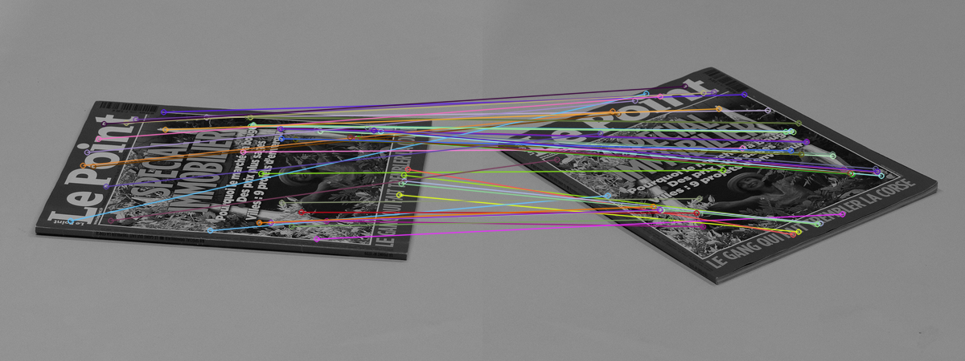
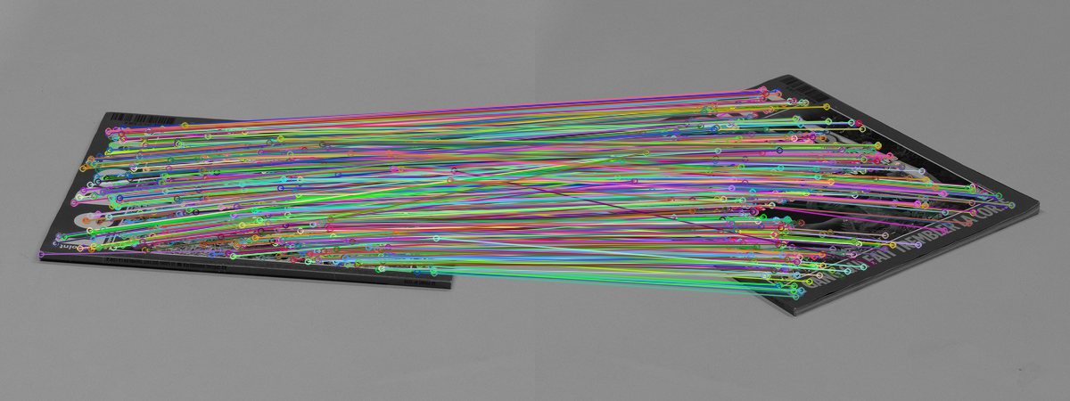
Starting Out
Used/modified an existing implementation of ASIFT
BRISK over SIFT – ABRISK
Matched keypoints using brute force KNN matching
Too many matches in some cases, especially visually
Limiting displayed matches (to 75)
Eliminating bad matches using Lowe's ratio test
Limiting matches shown, but with bad matches
Better matches, but with every match shown

Slide 4
Attempted Modifications
SIFT over BRISK for keypoint detection
Turned out to be moderately slower compared to BRISK
LSH (locality-sensitive hashing) for matching
Similar slowness
Changes in match quality were difficult to measure between different matchers/keypoint descriptors.

Slide 5
Final/Current Changes
KD-Tree matching via FLANN (Fast Library for Approximate Nearest Neighbors)
Some parallelization of ABRISK
Approximate 1.5-2x speedup for finding keypoints

Slide 6
Results

Slide 7
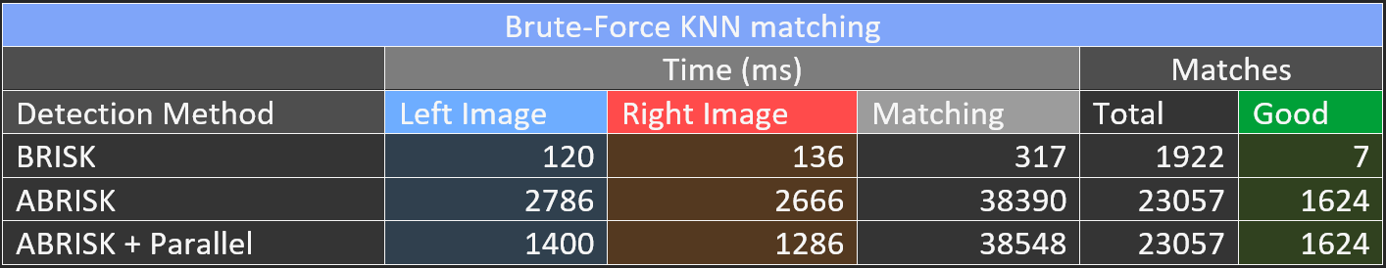
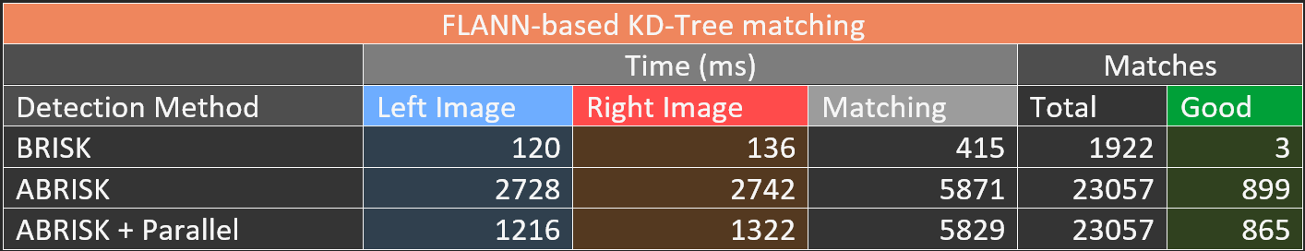

Slide 8
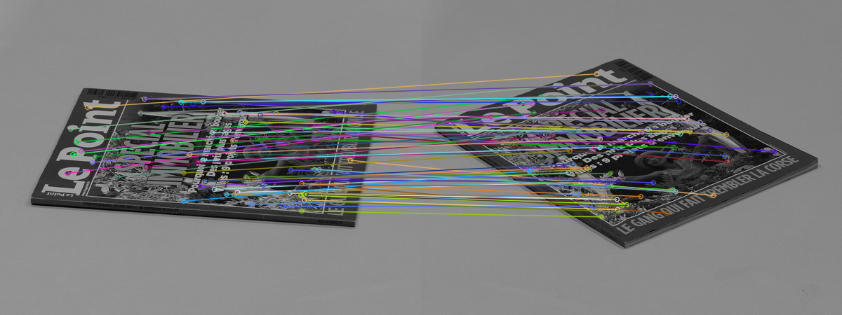
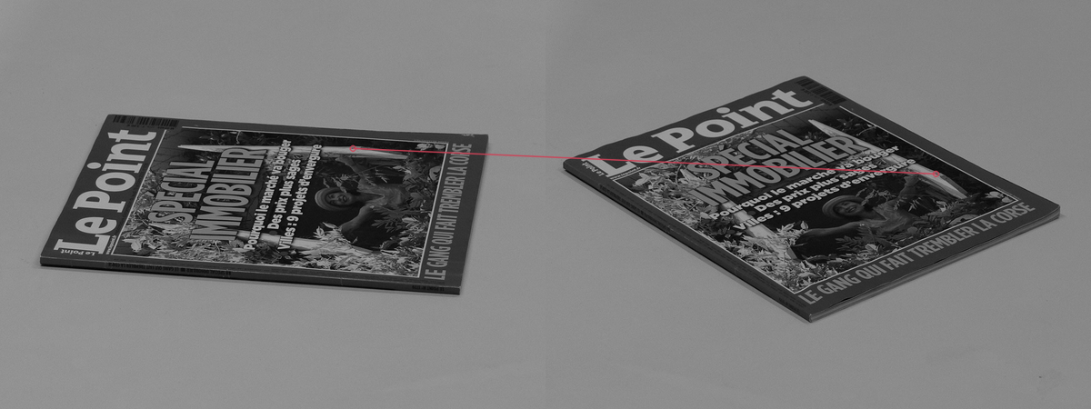
ABRISK + FLANN-Based Matcher + Parallelization
869 Matches
Left Keypoints: 1381 ms
Right Keypoints: 1329 ms
Matching Time: 5808 ms
BRISK + FLANN-Based Matcher
1 Match
Left Keypoints: 125 ms
Right Keypoints: 138 ms
Matching Time: 417 ms

Slide 9
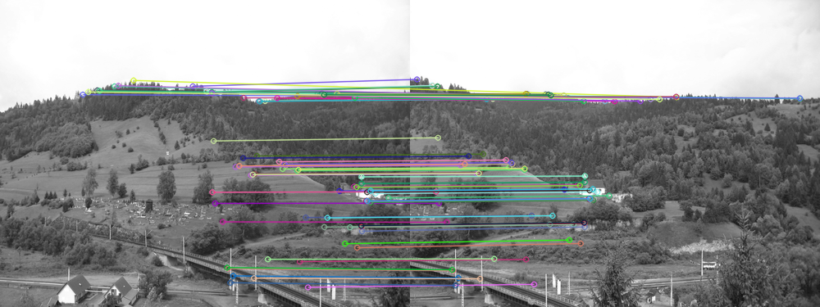
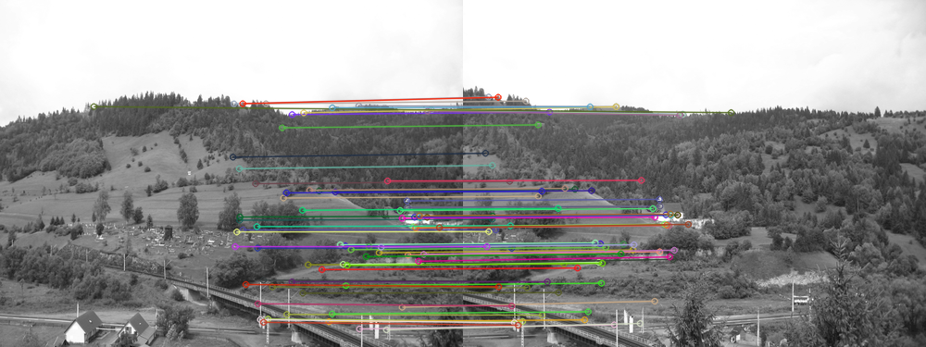
ABRISK + FLANN-Based Matcher + Parallelization
856 Matches
Left Keypoints: 1011 ms
Right Keypoints: 1020 ms
Matching Time: 3492 ms
BRISK + FLANN-Based Matcher
164 Matches
Left Keypoints: 99 ms
Right Keypoints: 102 ms
Matching Time: 279 ms

Slide 10
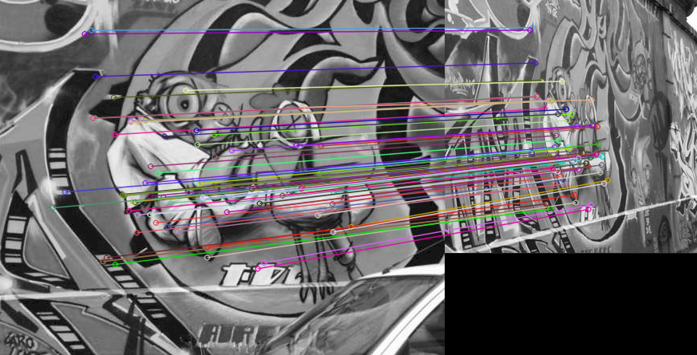
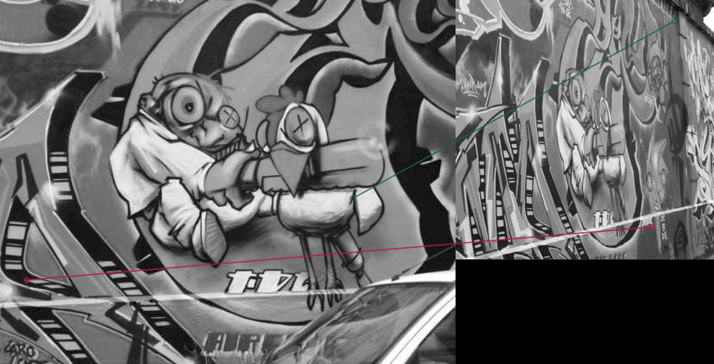
ABRISK + FLANN-Based Matcher + Parallelization
522 Matches
Left Keypoints: 1490 ms
Right Keypoints: 958 ms
Matching Time: 10689 ms
BRISK + FLANN-Based Matcher
2 Matches
Left Keypoints: 153 ms
Right Keypoints: 111 ms
Matching Time: 448 ms

Slide 11
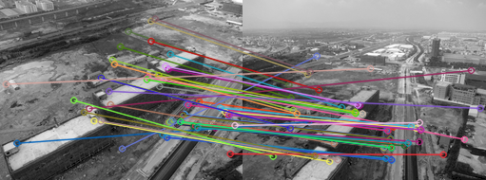
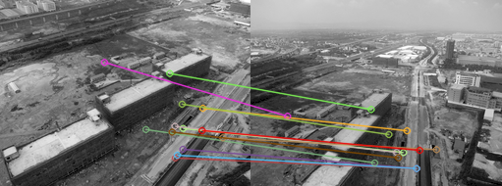
ABRISK + FLANN-Based Matcher + Parallelization
57 Matches
Left Keypoints: 590 ms
Right Keypoints: 646 ms
Matching Time: 1118 ms
BRISK + FLANN-Based Matcher
13 Matches
Left Keypoints: 51 ms
Right Keypoints: 60 ms
Matching Time: 93 ms

Slide 12
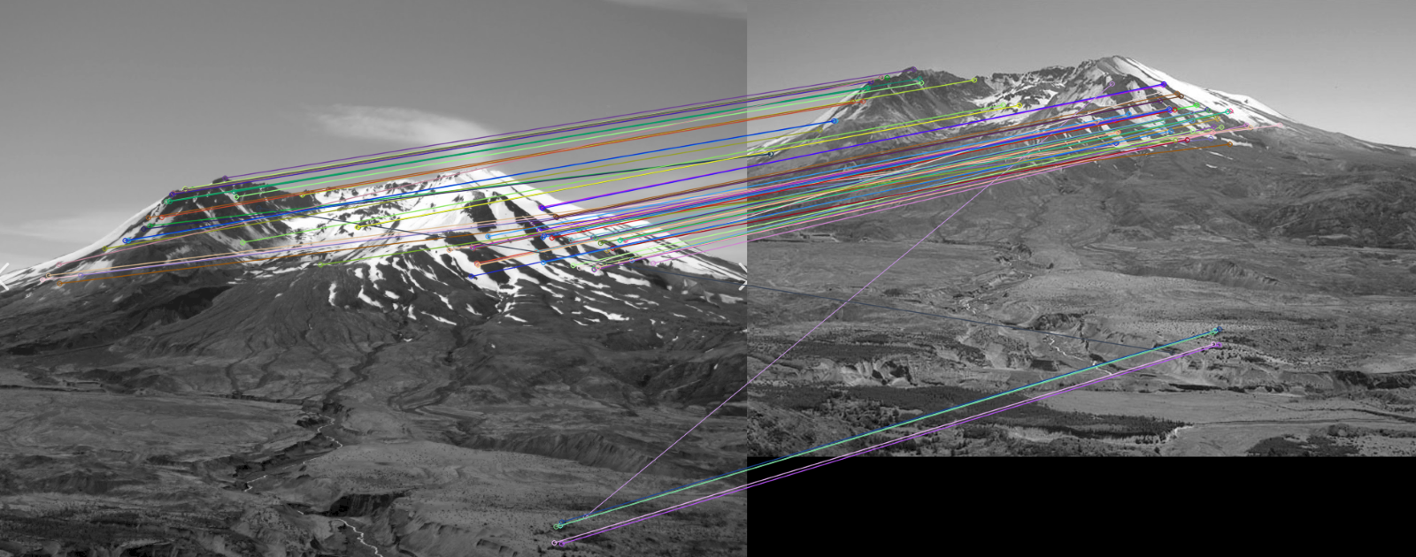
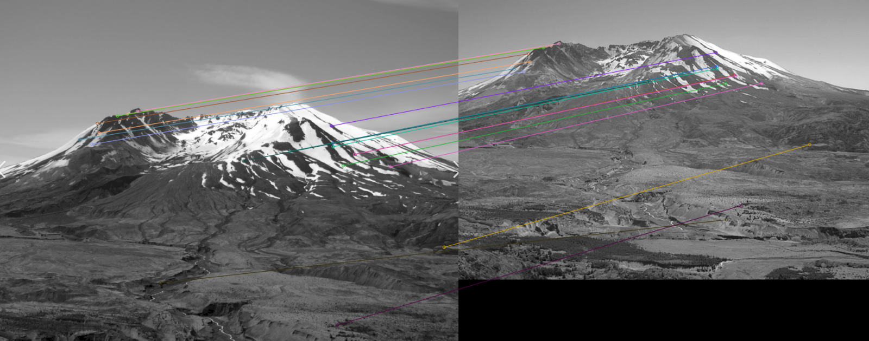
ABRISK + FLANN-Based Matcher + Parallelization
191 Matches
Left Keypoints: 2732 ms
Right Keypoints: 2157 ms
Matching Time: 13387 ms
BRISK + FLANN-Based Matcher
19 Matches
Left Keypoints: 231 ms
Right Keypoints: 229 ms
Matching Time: 838 ms

Slide 13

Possible Improvements
More parallelization
CUDA/Graphics card utilization
Eliminating bad matches more accurately
Fundamental matrix via RANSAC
Exploring more ways to evaluate quality of matches

